Slide 1
Unified Modeling Language (UML )
Chapter 2

Slide 2
Introduction
The UML has changed the way computer applications are developed
The introduction of UML has offered system developers, designers, and project managers a unified way to communicate about a system
the UML provides a simplified Application Life Cycle Development (ALCD), as well as a quick and efficient development process.

Slide 3
What is The UML
The Unified Modeling Language (UML) is a graphical language for visualizing, specifying, constructing, and documenting the artifacts of a system-intensive system” (Booch, 1999).
UML is a notation that resulted from the unification of OMT (Object Modeling Techinidue) and OOSE (Object Oriented software engineering)

Slide 4
The Goal Of UML
To provide a standard notation that can be used by all object-oriented models
To select and integrate the best elements of predecessor notations such as use case diagrams from OOSE and class diagrams from OMT
UML includes new concepts that were not present in other major methods

Slide 5
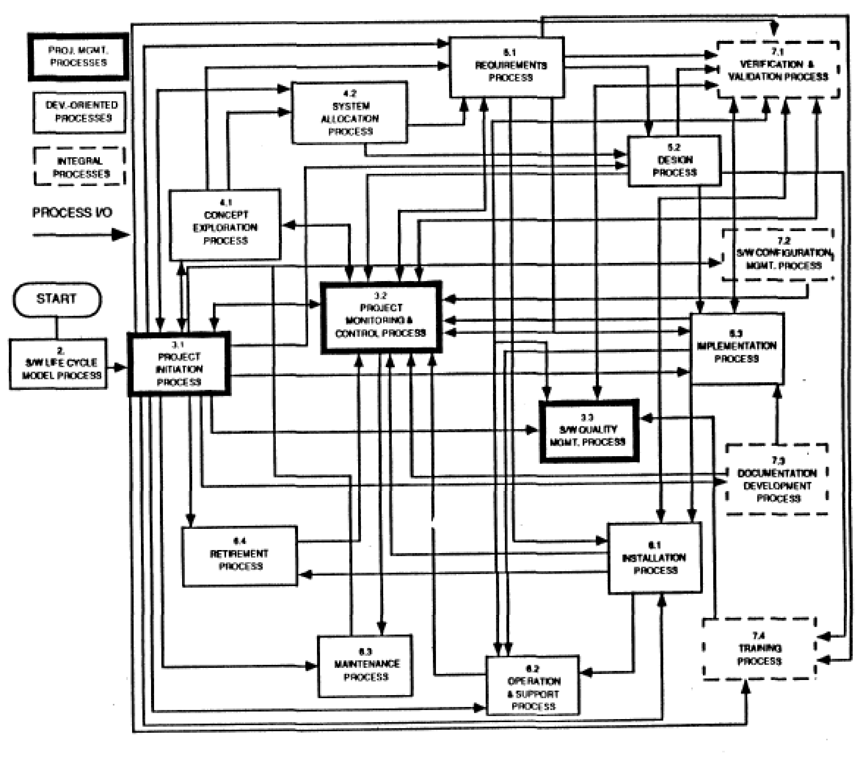
What is the problem with this Drawing?

Slide 6
Abstraction
Complex systems are hard to understand
The 7 +- 2 phenomena
Our short term memory cannot store more than 7+-2 pieces at the same time -> limitation of the brain
My Phone Number: 498928918204
Chunking:
Group collection of objects to reduce complexity
State-code, Area-code, Local Prefix, Internal-Nr
Phone Number
Country-Code
Area-Code
Local-Prefix
Internal-Nr

Slide 7
Abstraction
Abstraction allows us to ignore unessential details
Two definitions for abstraction:
Abstraction is a thought process where ideas are distanced from objects
Abstraction as activity
Abstraction is the resulting idea of a thought process where an idea has been distanced from an object
Abstraction as entity
Ideas can be expressed by models

Slide 8
Models
A model is an abstraction of
A system that no longer exists
An existing system
A future system to be built
We use Models to describe Software Systems
Object model: What is the structure of the system?
Functional model: What are the functions of the system?
Dynamic model: How does the system react to external events?
System Model: Object model + functional model + dynamic model

Slide 9
Cont..
functional model represented in UML with use case diagrams, describes the functionality of the system from the user’s point of view.
Object model, represented in UML with class diagrams, describes the structure of the system in terms of objects, attributes, associations, and operations.
dynamic model, represented in UML with interaction diagrams, state machine diagrams, and activity diagrams, describes the internal behavior of the system.

Slide 10
UML Core Conventions and Notation
All UML Diagrams denote graphs of nodes and edges
Nodes are entities and drawn as rectangles or ovals
Rectangles denote classes or instances
Ovals denote functions
Names of Classes are not underlined
SimpleWatch
Firefighter
Names of Instances are underlined
myWatch:SimpleWatch
Joe:Firefighter
An edge between two nodes denotes a relationship between the corresponding entities

Slide 11
The UML Diagrams
UML offers different types of diagrams, which would help system designers, achieve their goals when designing a software system

Slide 12
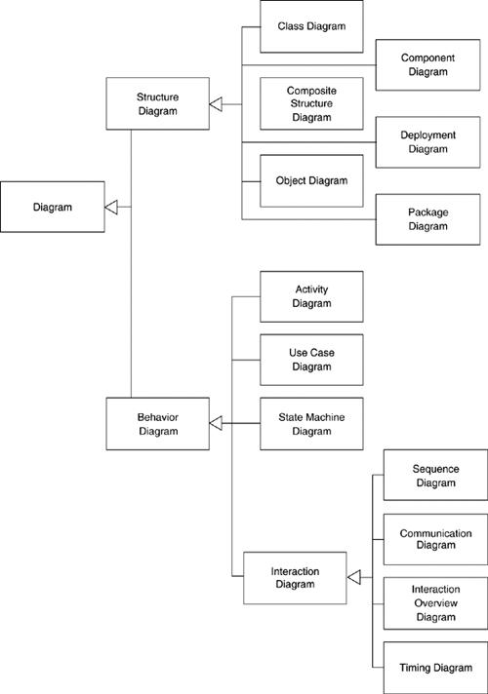
UML Diagrams (Cont..)

Slide 13
UML Diagrams (Cont..)
Diagram Purpose Lineage
Activity Procedural and parallel behavior In UML 1
Class Class, features, and relationships In UML 1
Communication Interaction between objects; emphasis on links UML 1
Component Structure and connections of components In UML 1
Composite structure Runtime decomposition of a class New to UML 2
Deployment Deployment of artifacts to nodes In UML 1
Interaction overview Mix of sequence and activity diagram New to UML 2
Object Example configurations of instances Unofficially in UML 1
Package Compile-time hierarchic structure Unofficially in UML 1
Sequence Interaction between objects; emphasis on sequence In UML 1
State machine How events change an object over its life In UML 1
Timing Interaction between objects; emphasis on timing New to UML 2
Use case How users interact with a system In UML 1

Slide 14
UML Diagrams (Cont..)
Use-case Diagrams: to model the functionality using actors and use-cases
Class Diagrams: the backbone of every object-oriented method, including UML
Package Diagrams: a subset of class diagrams
Object Diagrams: test class diagrams for accuracy
Sequence Diagrams: describe interactions among classes (i.e., messages exchanged)
Collaboration Diagrams: represent interactions between objects as a series of sequenced messages
State-Chart Diagrams: model reactive objects, where states are triggered by specific events
Activity Diagrams: model workflow or business processes and internal operations
Component Diagrams: model the organization of physical software components (i.e., source code, run-time code, .exe files)
Deployment Diagrams: depict physical resources in a system (i.e., nodes, components, and connections)

Slide 15
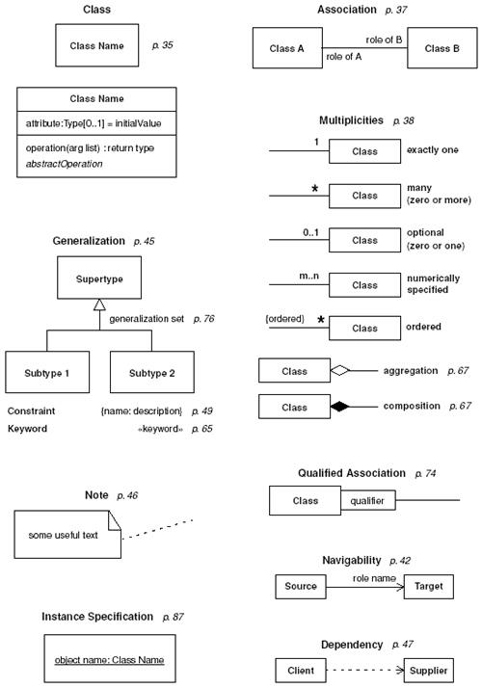

Slide 16
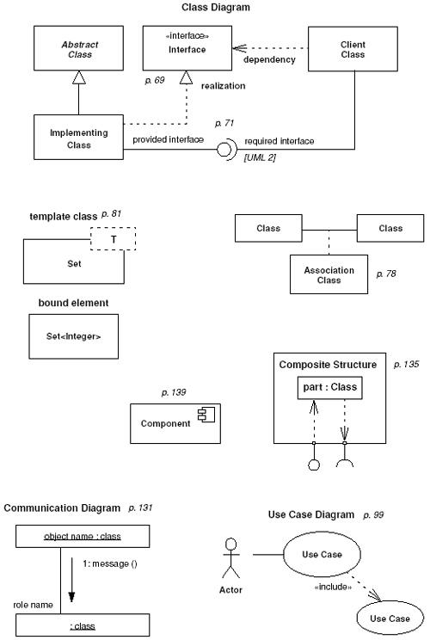

Slide 17
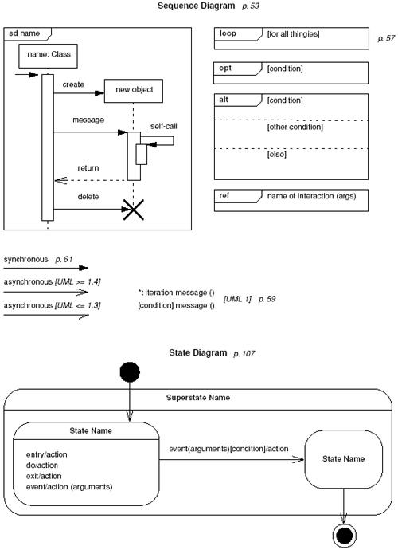

Slide 18
UML Diagrams (Cont..)
Interaction diagrams describe behavior as a sequence of messages exchanged among a set of objects.
state machine diagrams describe behavior in terms of states of an individual object and the possible transitions between states.
Activity diagrams describe behavior in terms control and data flows.

Slide 19
The UML Diagrams (Cont..)
Use case diagrams
Describe the functional behavior of the system as seen by the user
Class diagrams
Describe the static structure of the system: Objects, attributes, associations
Sequence diagrams
Describe the dynamic behavior between objects of the system
Statechart diagrams
Describe the dynamic behavior of an individual object
Activity diagrams
Describe the dynamic behavior of a system, in particular the workflow.

Slide 20
Use Case Diagrams
Represent the functionality of a system from a user’s point of view
They define the boundaries of the system
We need “use cases” to represent the functionality of the system
Use cases focus on the behavior of the system from an external point of view

Slide 21
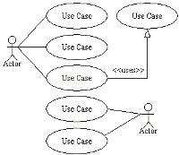
Use case diagrams (Cont.)
Use-case Diagrams - Use-case diagrams model the functionality of a system using actors and use-cases (Rumbaugh, Booch, and Jacobson, 1999).

Slide 22
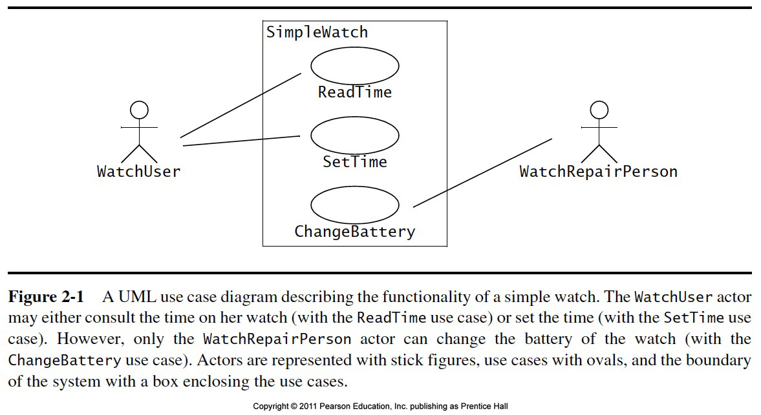
Cont..

Slide 23
Use Case Model for Incident Management
<<initiates>>
<<initiates>>
FieldOfficer
Dispatcher
OpenIncident
<<initiates>>
ReportEmergency
AllocateResources

Slide 24
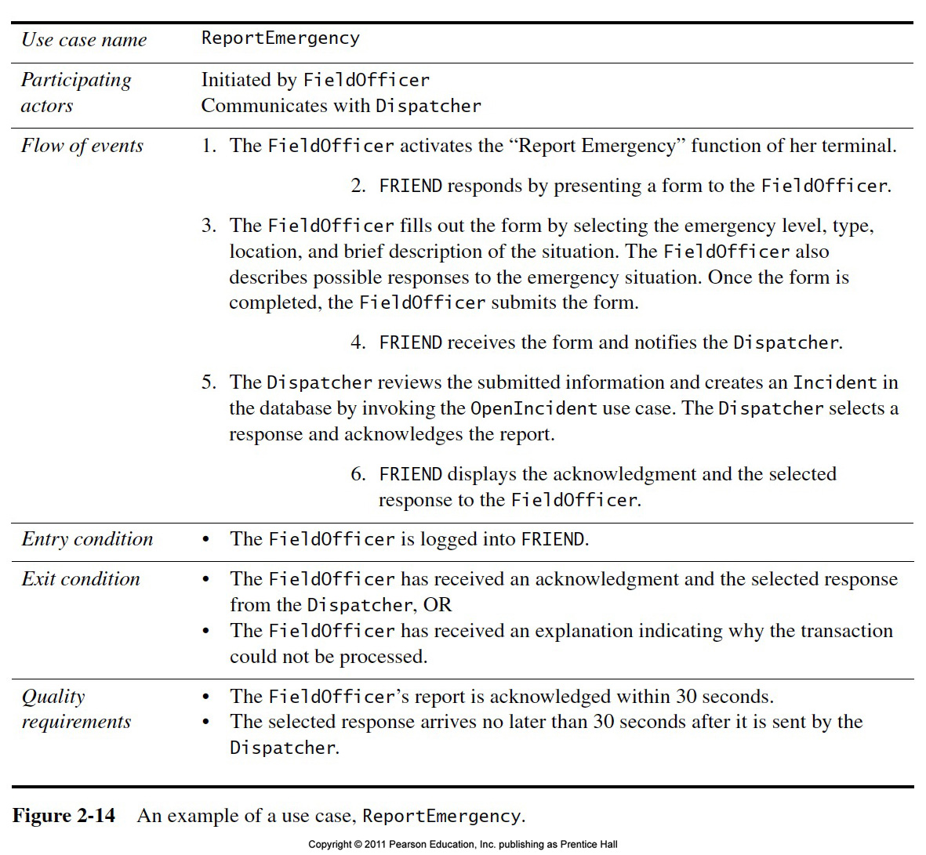

Slide 25
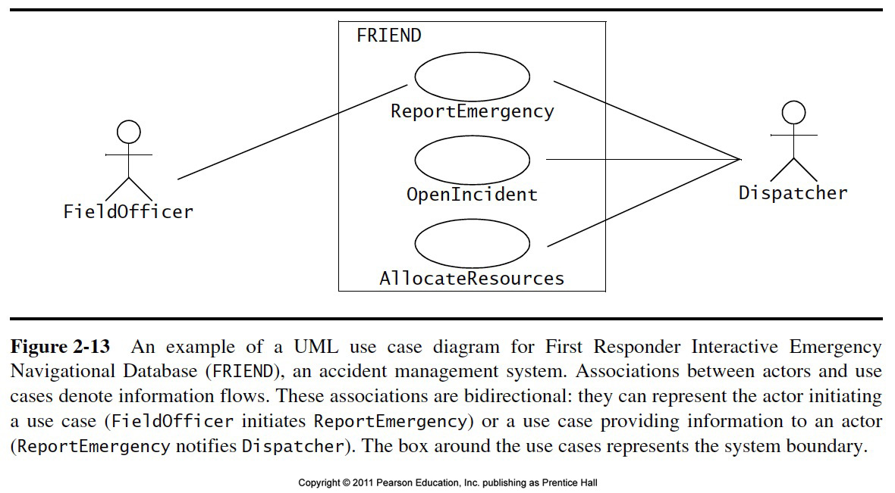

Slide 26
UML first pass: Use case diagrams
Classifier
Use Case
Actor.
System boundary
Use case diagrams represent the functionality of the system
from user’s point of view

Slide 27
UML Use Case Diagrams
An Actor represents a role, that is, a type of user of the system
A use case represents a class of functionality provided by the system
Passenger
Use case model:
The set of all use cases that completely describe the functionality of the system.
PurchaseTicket

Slide 28
Actors
An actor is a model for an external entity which interacts (communicates) with the system:
User
External system (Another system)
Physical environment (e.g. Weather)
An actor has a unique name and an optional description
Examples:
Passenger: A person in the train
GPS satellite: An external system that provides the system with GPS coordinates.
Passenger
Optional
Description
Name

Slide 29
Use Case
• A use case represents a class of functionality provided by the system
• Use cases can be described textually, with a focus on the event flow between actor and system
• The textual use case description consists of 6 parts:
Unique name
Participating actors
Entry conditions
Exit conditions
Flow of events
Special requirements.
PurchaseTicket

Slide 30
Uses Cases can be related
Extends Relationship
To represent seldom invoked use cases or exceptional functionality
Includes Relationship
To represent functional behavior common to more than one use case.

Slide 31
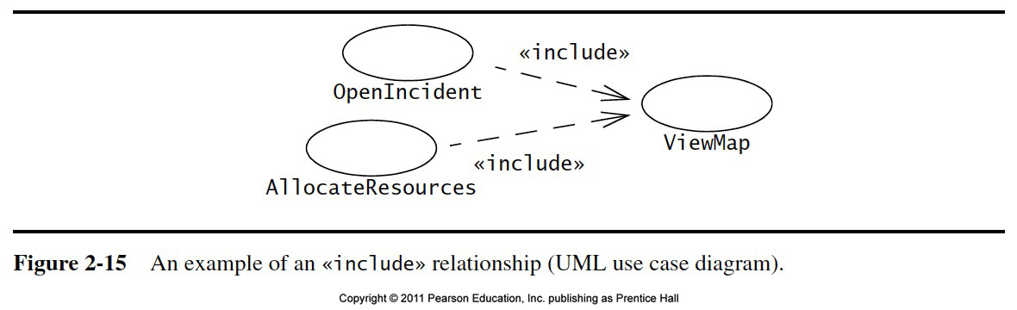
<<Include>>

Slide 32
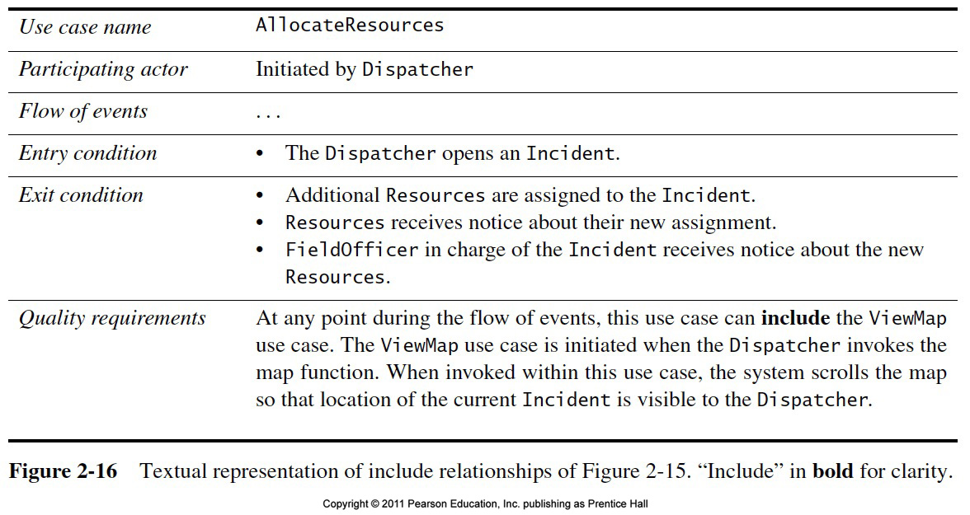

Slide 33
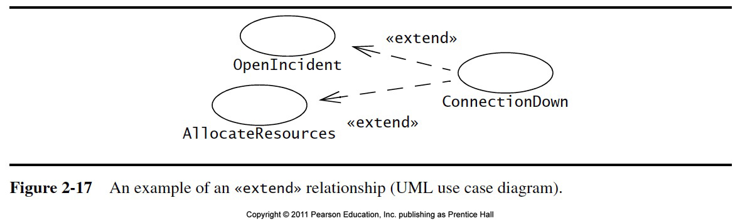
<<extend>>

Slide 34
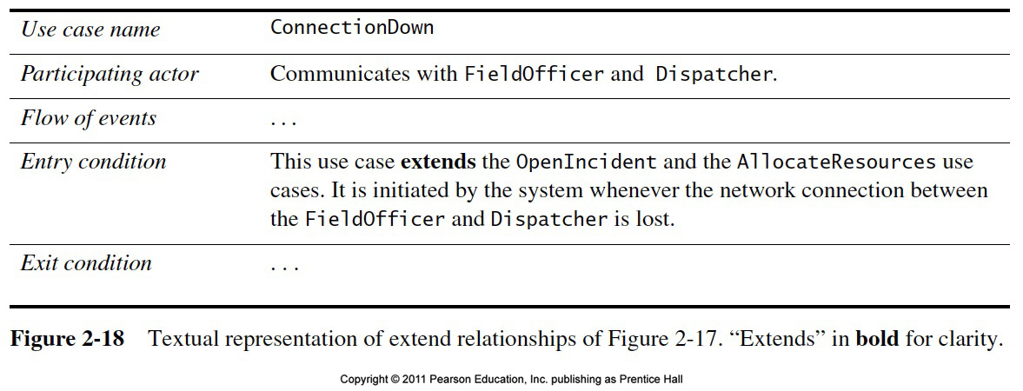
<<extend>>

Slide 35
The <<extends>> Relationship
<<extends>> relationships model exceptional or seldom invoked cases
The exceptional event flows are factored out of the main event flow for clarity
The direction of an <<extends>> relationship is to the extended use case
Use cases representing exceptional flows can extend more than one use case.
Passenger
PurchaseTicket
<<extends>>
<<extends>>
<<extends>>
OutOfOrder
<<extends>>
TimeOut
Cancel
NoChange

Slide 36
The <<includes>> Relationship
<<includes>> relationship represents common functionality needed in more than one use case
<<includes>> behavior is factored out for reuse, not because it is an exception
The direction of a <<includes>> relationship is to the using use case (unlike the direction of the <<extends>> relationship).
Passenger
PurchaseMultiCard
PurchaseSingleTicket
<<includes>>
<<includes>>
<<extends>>
CollectMoney
<<extends>>
<<extends>>
NoChange
Cancel
Cancel

Slide 37
Class Diagrams
Class diagrams describes the static structure of the system in terms of
Objects and their attributes
operations and relationships
Classes are abstractions that specify the common structure and behavior of a set of objects
Objects are instances of classes that are created, modified, and destroyed during the execution of the system

Slide 38
Class Diagrams (Cont.)
Class diagrams are the backbone of almost every object-oriented method, including UML. They describe the static structure of a system (Rumbaugh, Booch, and Jacobson, 1999).

Slide 39
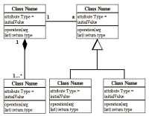
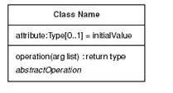
Class Diagrams (Cont.)

Slide 40
UML first pass: Class diagrams
Association
Class
Multiplicity
SimpleWatch
1
1
1
1
2
1
2
1
PushButton
Display
Battery
Time
Class diagrams represent the structure of the system

Slide 41
UML first pass: Class diagrams
Class diagrams represent the structure of the system
Association
Class
Multiplicity
Watch
1
1
1
1
2
1
2
1
PushButton
state
LCDDisplay
Battery
Load
Time
Now
push() release()
blinkIdx
blinkSeconds()
blinkMinutes()
blinkHours()
stopBlinking()
referesh()
Operations
Attribute

Slide 42
Class Diagrams
Class diagrams represent the structure of the system
Used
during requirements analysis to model application domain concepts
during system design to model subsystems
during object design to specify the detailed behavior and attributes of classes.
TarifSchedule
Trip
Table zone2price
Enumeration getZones()
Price getPrice(Zone)
zone:Zone
Price: Price
*
*

Slide 43
Classes
Type
TarifSchedule
Table zone2price
Enumeration getZones()
Price getPrice(Zone)
Name
TarifSchedule
Attributes
Signature
zone2price
getZones()
getPrice()
Operations
TarifSchedule
A class represents a concept
A class encapsulates state (attributes) and behavior (operations)
Each attribute has a type
Each operation has a signature
The class name is the only mandatory information

Slide 44
Actor vs Class vs Object
Actor
An entity outside the system to be modeled, interacting with the system (“Passenger”)
Class
An abstraction modeling an entity in the application or solution domain
The class is part of the system model (“User”, “Ticket distributor”, “Server”)
Object
A specific instance of a class (“Joe, the passenger who is purchasing a ticket from the ticket distributor”).

Slide 45
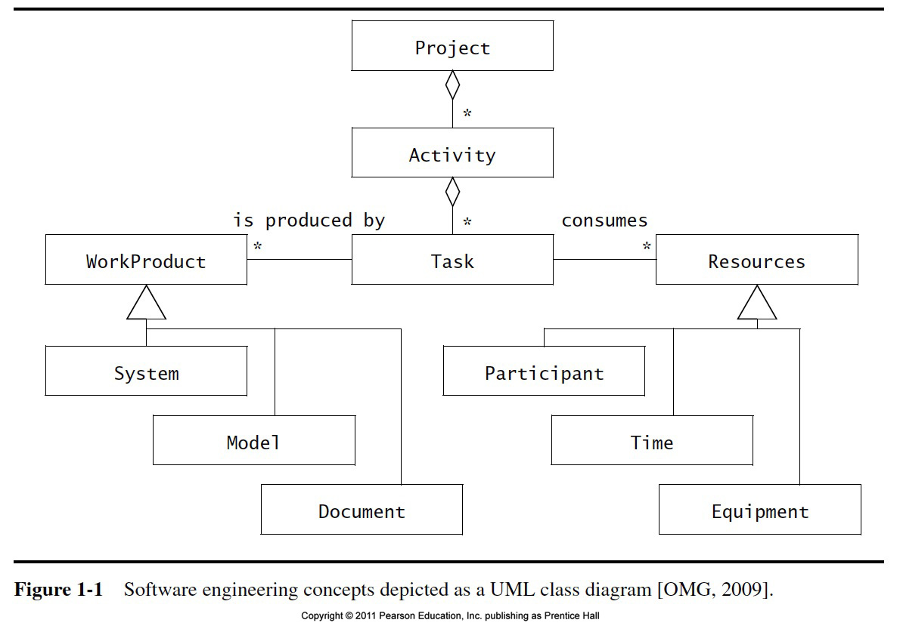
Class Diagrams (Cont.)

Slide 46
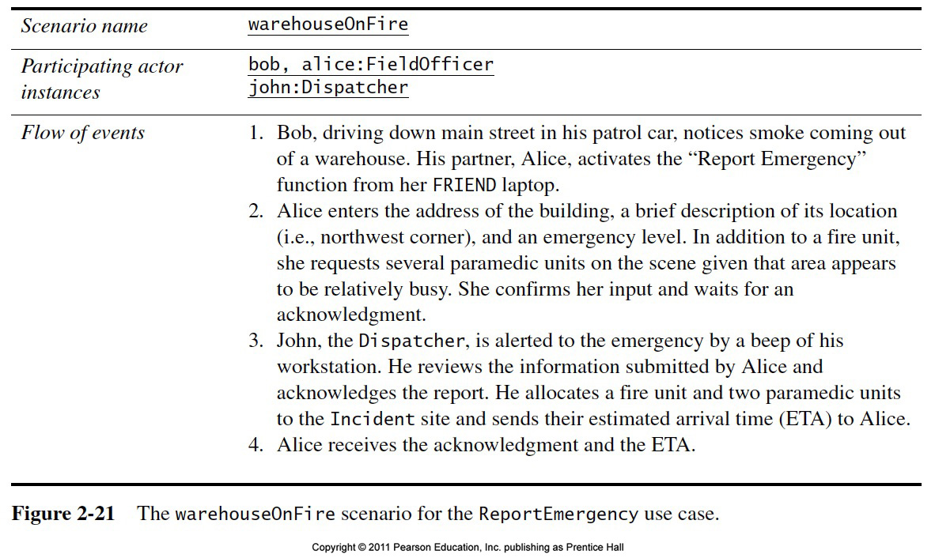
Use Case

Slide 47
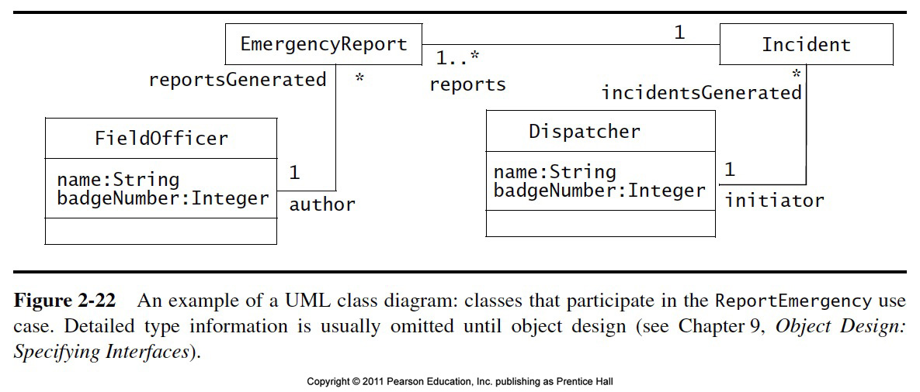
Class Diagram

Slide 48
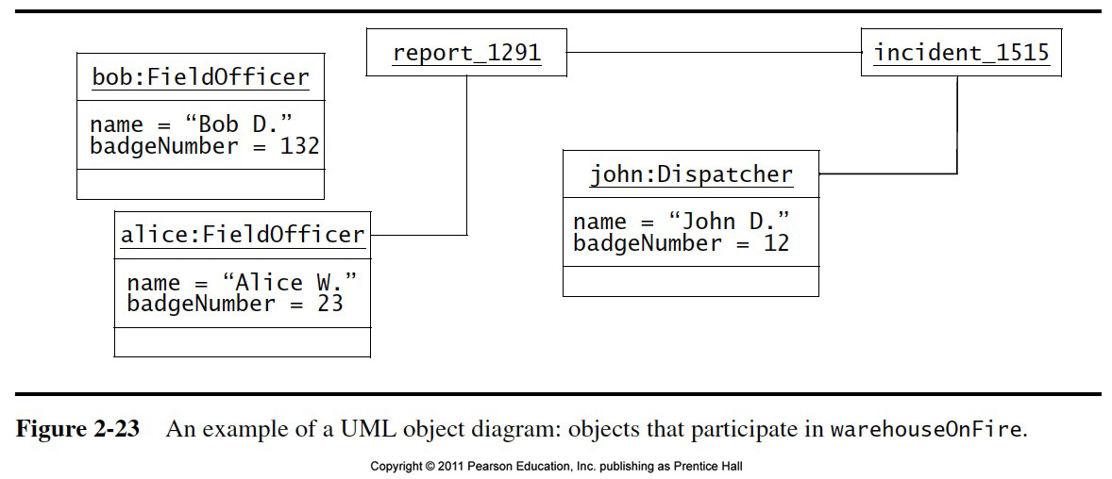
Object Diagram

Slide 49
Instances
tarif2006:TarifSchedule
:TarifSchedule
zone2price = {
{‘1’, 0.20}, {‘2’, 0.40},
{‘3’, 0.60}}
zone2price = {
{‘1’, 0.20}, {‘2’, 0.40},
{‘3’, 0.60}}
An instance represents a phenomenon
The attributes are represented with their values
The name of an instance is underlined
The name can contain only the class name of the instance (anonymous instance)

Slide 50
Associations
TarifSchedule
TripLeg
Enumeration getZones()
Price getPrice(Zone)
*
Price Zone
*
Associations denote relationships between classes
The multiplicity of an association end denotes how many objects the instance of a class can legitimately reference.

Slide 51
1-to-1 and 1-to-many Associations
Country
1
1
City
name:String
name:String
1-to-1 association
Point
Polygon
*
x: Integer
draw()
y: Integer
1-to-many association

Slide 52
Many-to-many Associations
*
*
Company
StockExchange
Lists
tickerSymbol
A stock exchange lists many companies.
Each company is identified by a ticker symbol

Slide 53
From Problem Statement To Object Model
Problem Statement: A stock exchange lists many companies. Each company is uniquely identified by a ticker symbol
Class Diagram:
StockExchange
*
*
Company
Lists
tickerSymbol

Slide 54
Aggregation
An aggregation is a special case of association denoting a “consists-of” hierarchy
The aggregate is the parent class, the components are the children classes
Exhaust system
1
0..2
Muffler
Tailpipe
diameter
diameter
A solid diamond denotes composition: A strong form of aggregation where the life time of the component instances is controlled by the aggregate. That is, the parts don’t exist on their won (“the whole controls/destroys the parts”)
TicketMachine
3
ZoneButton

Slide 55
Inheritance
Button
CancelButton
ZoneButton
Inheritance is another special case of an association denoting a “kind-of” hierarchy
Inheritance simplifies the analysis model by introducing a taxonomy
The children classes inherit the attributes and operations of the parent class.

Slide 56
Packages
Packages help you to organize UML models to increase their readability
We can use the UML package mechanism to organize classes into subsystems
Any complex system can be decomposed into subsystems, where each subsystem is modeled as a package.
Account
Bank
Customer

Slide 57
Object Modeling in Practice
Foo
Amount
CustomerId
Deposit()
Withdraw()
GetBalance()
Class Identification: Name of Class, Attributes and Methods
Is Foo the right name?

Slide 58
Interaction Diagrams
Represent a system’s behavior in terms of interactions among a set of objects
Interaction diagrams are used to formalize the dynamic behavior of the system and visualize the communication among objects
Participating Objects are Objects involved in a use case
Sequence diagrams are a special form of interaction diagrams

Slide 59
Sequence Diagrams
Focus on
Controlflow
Used during analysis
To refine use case descriptions
to find additional objects (“participating objects”)
Used during system design
to refine subsystem interfaces
Instances are represented by rectangles. Actors by sticky figures
Lifelines are represented by dashed lines
Messages are represented by arrows
Activations are represented by narrow rectangles.
Passenger
TicketMachine
selectZone()
TicketMachine
insertCoins()
zone2price
selectZone()
insertCoins()
pickupChange()
pickUpTicket()
Messages ->
Operations on
participating Object
pickupChange()
pickUpTicket()

Slide 60
Sequence Diagrams can also model the Flow of Data
Passenger
ZoneButton
TarifSchedule
Display
selectZone()
lookupPrice(selection)
price
Dataflow
displayPrice(price)
…continued on next slide...
The source of an arrow indicates the activation which sent the message
Horizontal dashed arrows indicate data flow, for example return results from a message

Slide 61
Sequence Diagrams: Iteration & Condition
…continued from previous slide...
Passenger
ChangeProcessor
CoinIdentifier
Display
CoinDrop
*
insertChange(coin)
lookupCoin(coin)
Iteration
price
displayPrice(owedAmount)
Condition
[owedAmount<0] returnChange(-owedAmount)
…continued on next slide...
Iteration is denoted by a * preceding the message name
Condition is denoted by boolean expression in [ ] before the message name

Slide 62
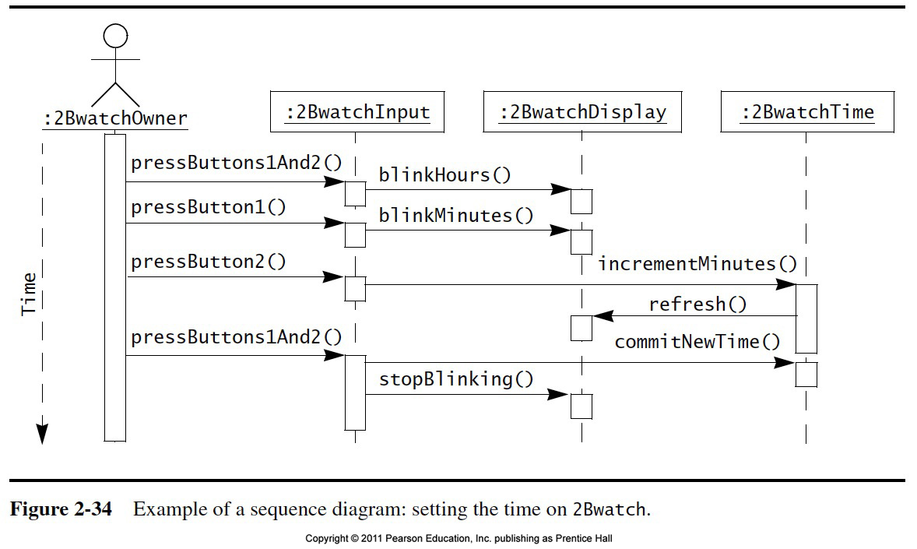
Sequence diagrams

Slide 63
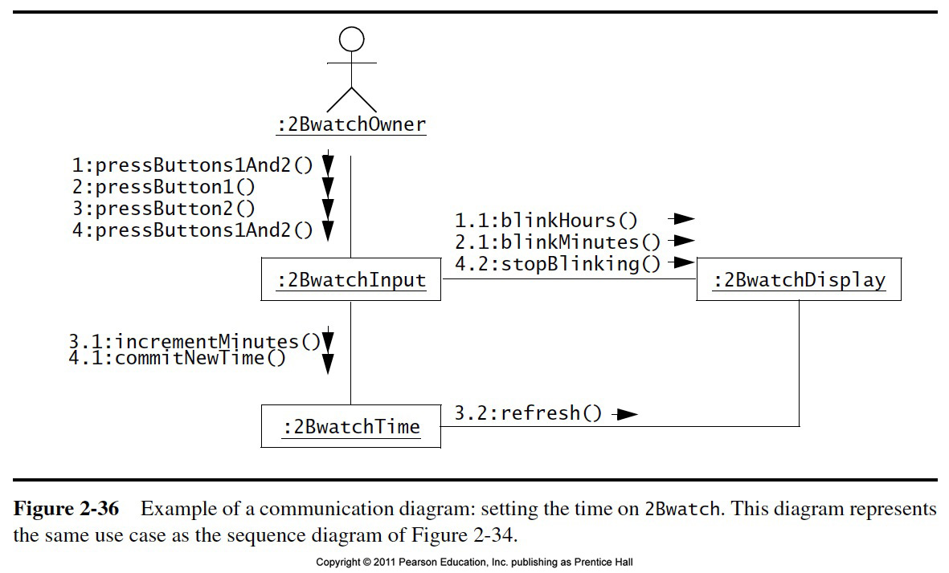
Communication Diagram

Slide 64
State Machine Diagrams (SMD)
State machine diagrams describe the dynamic behavior of an individual object as a number of states and transition
A state is a particular set of values for an object
Given a state a transition represents future state the object can move to

Slide 65
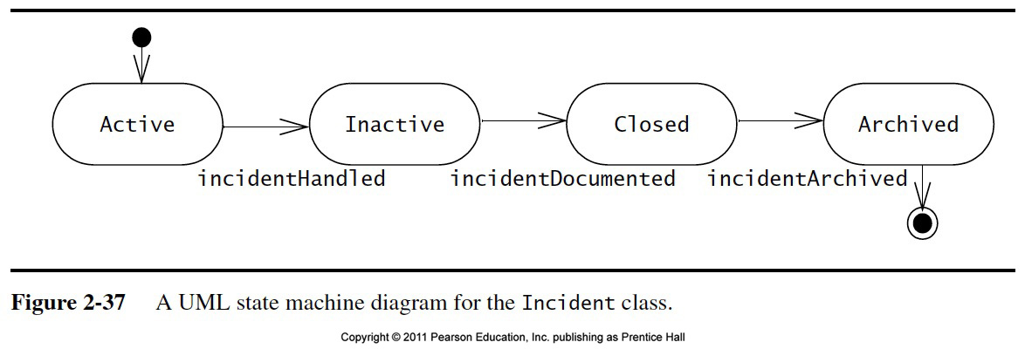
SMD Example

Slide 66
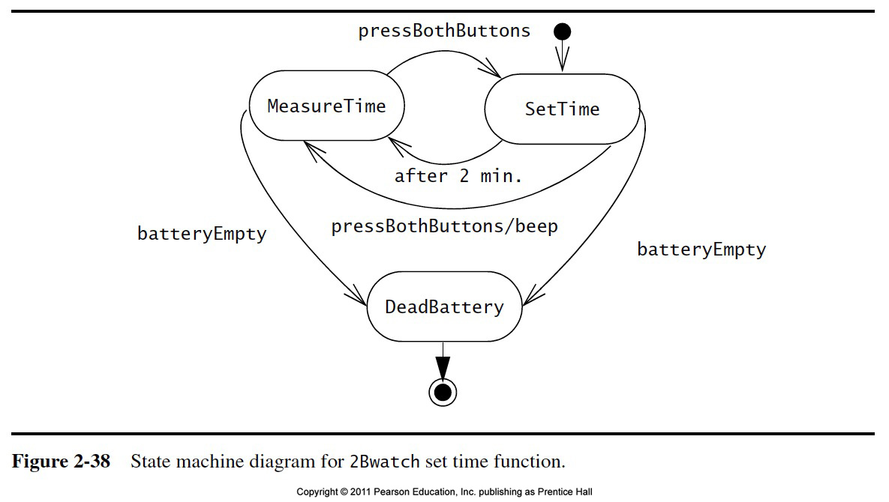
SMD Example

Slide 67
Activity Diagrams
They are flow diagrams used to represent the data flow or control flow through a system.
Describes the behavior of a system in term of activities
Activities are modeling elements that represent the execution of a set of operations
Execution of an activity can be triggered
by the completion of other activities
by the availability of objects
By external events
Activity Diagrams are similar to the flowchart diagrams

Slide 68
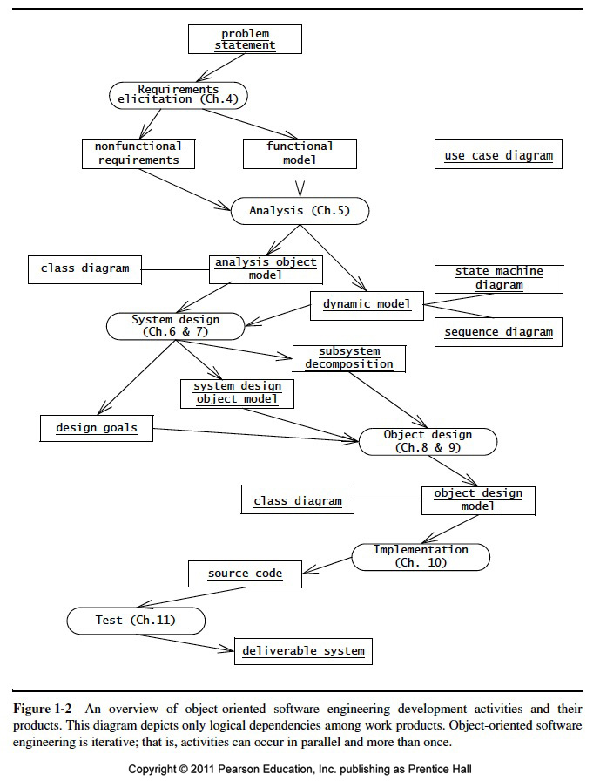
Activity Diagram

Slide 69
More UML
The following abbreviations are usually used for diagram frames:
act (for activity frames)
cmp (for component frames)
sd (for interaction frames)
pkg (for package frames)
stm (for state machine frames)
uc (for use case frames)
Activity diagram
Class diagram
Component diagram
Interaction diagram
Package
state machine diagram
Use case diagram

Slide 70
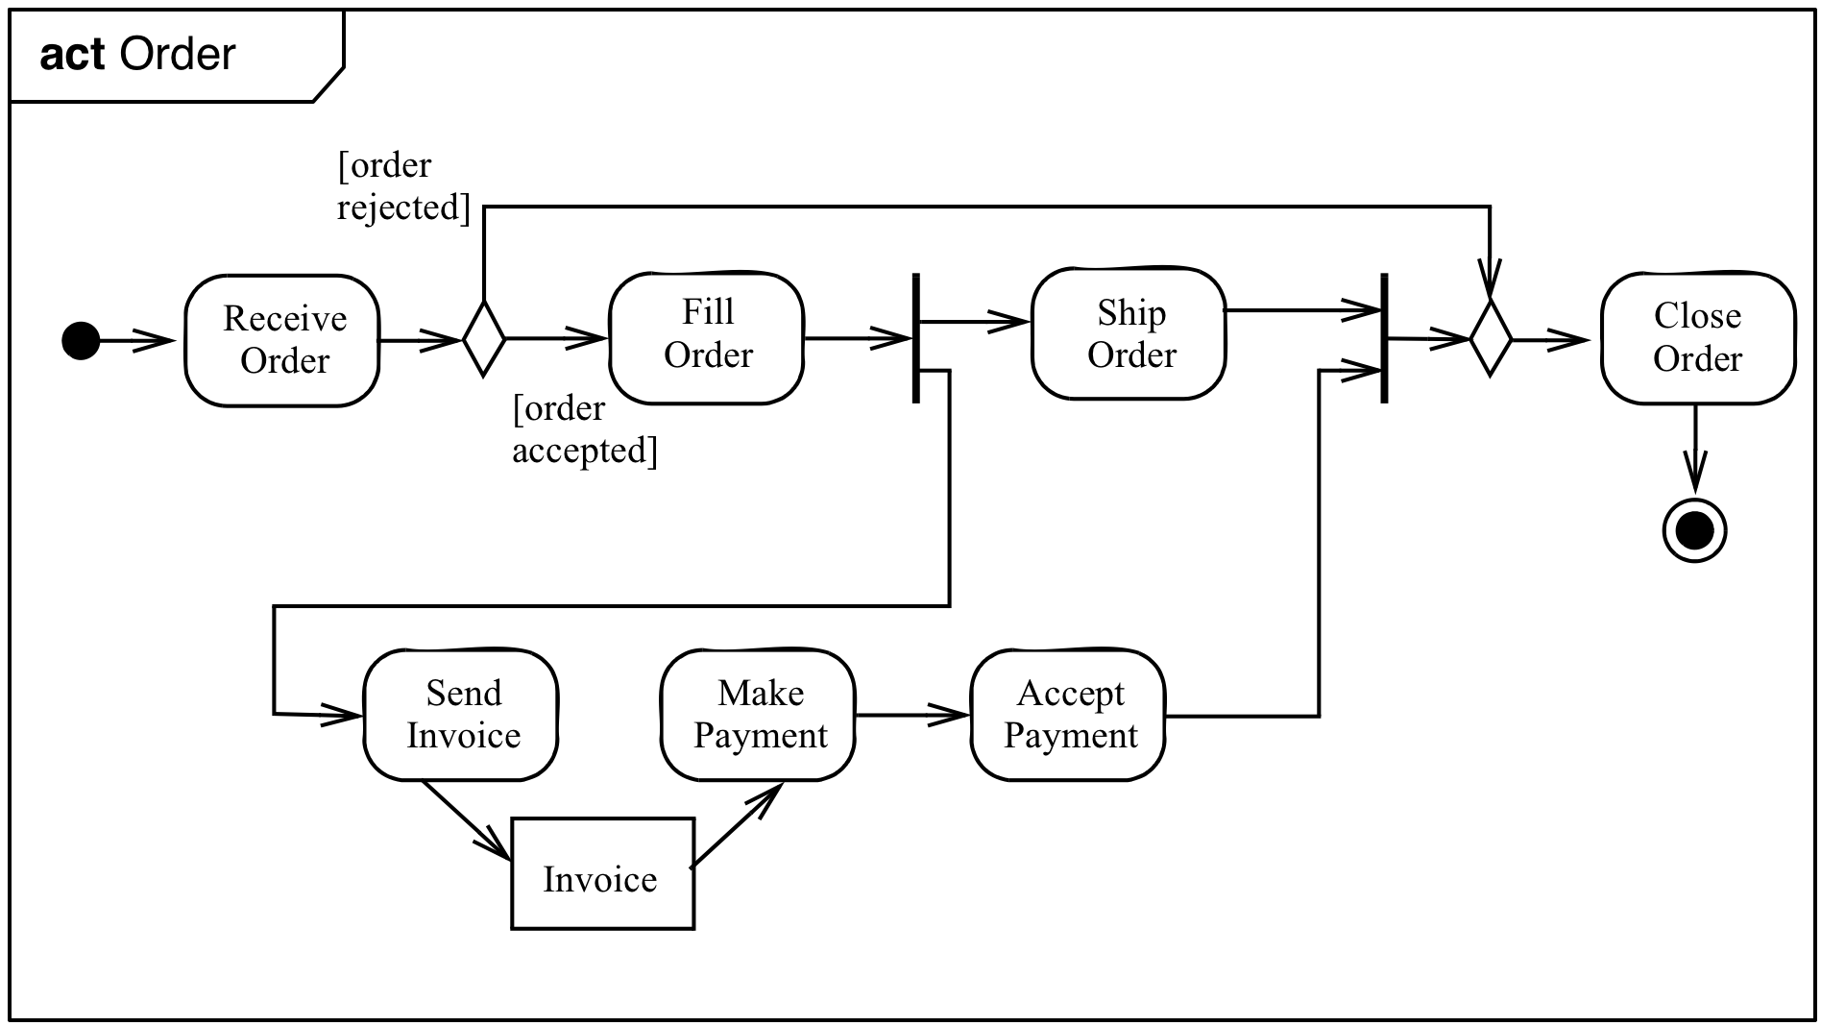
Example of a Activity Diagram with a Frame

Slide 71
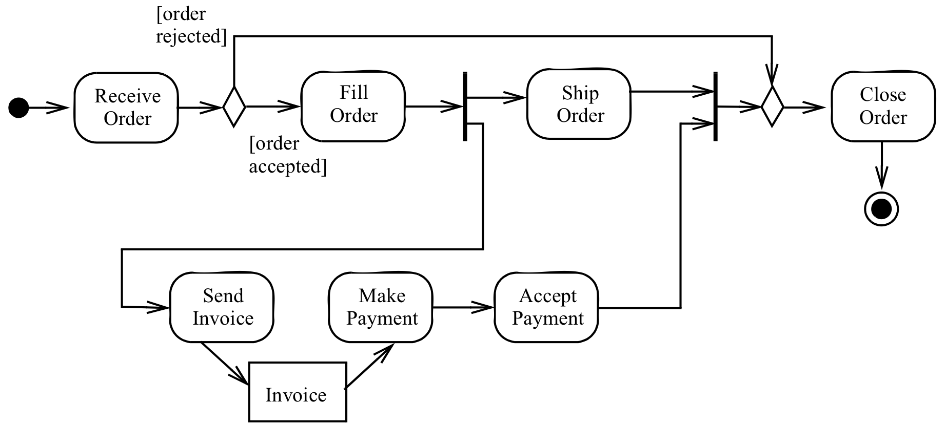
The Activity Diagram without Frame
Notes:
Initial Node (Control)
Decision Node

Slide 72
Action Nodes and Object Nodes
Action Node
Object Node
An action is part of an activity which has local pre- and post conditions
Historical Remark:
In UML 1 an action was the operation on the transition of a state machine.
Action
Name
Object
Name
Write
Thesis
Thesis
ReviewThesis

Slide 73
Activity Diagram Example
Action
Object node
Notes:
Initial Node (Control)
Decision Node

Slide 74
Activity Diagram: Activity Nodes & Edges
An activity diagram consists of nodes and edges
There are three types of activity nodes
Control nodes
Executable nodes
Most prominent: Action
Object nodes
E.g. a document
An edge is a directed connection between nodes
There are two types of edges
Control flow edges
Object flow edges

Slide 75
Activity Diagram Example
Control flow
Object flow
Notes:
Initial Node (Control)
Decision Node

Slide 76
Summary: Activity Diagram Example
Fork node
Join node
Merge node
Initial node
Control flow
Final node
Action
Object node
Object flow
Notes:
Initial Node (Control)
Decision Node

